Slide 1


Pramit Bhattacharya
01/29/2026

Slide 2

Outline
Executive Summary
Introduction
Methodology
Results
Conclusion
Appendix

Slide 3
Executive Summary
Methodologies Summary
Data collection with API
Data collection using Web Scraping
Data wrangling
Exploratory Data Analysis with SQL
Exploratory Data Analysis with Visualization
Interactive Visual Analytics with Folium
Interactive Dashboard with Plotly Dash
Machine Learning Prediction
Results Summary
Improved success Rate over Time
KSC LC-39A had highest success Rate by Launch Site
Highest success Rate by Orbit for SSO, ES-L1, HEO, GEO
Lightening payloads increases their success rate
Algorithms can be classified ass highly accurate and not-highly accurate

Slide 4
Introduction
Project background and context
SpaceX launches Falcon 9 launches at $62 million dollars per mission, as compared to their competitors (around $165 million).
They have this edge due to huge cost reduction from first stage reuse for their rockets.
Competitors can also gain this edge, by calculating whether their rocket's first stage will land successfully, which will greatly reduce overall rocket launching costs.
Problems you want to find answers
Variables influencing a rocket’s successful landing?
How is probability of a safe landing impacted by the interconnectedness of different features?
Operational conditions needed to be met for consistent successful landings.

Slide 5

Section 1

Slide 6
Methodology
Executive Summary
Data collection methodology:
Data was gathered through the SpaceX API, along with additional information obtained by scraping Wikipedia pages.
Perform data wrangling
Categorical variables were transformed using one-hot encoding, relevant entries were selected, and nested fields were flattened while handling missing data
Perform exploratory data analysis (EDA) using visualization and SQL
Perform interactive visual analytics using Folium and Plotly Dash
Perform predictive analysis using classification models
Developed, tune, assessed, and compared multiple classification models for prediction tasks.

Slide 7
Data Collection
Data collection and transformation methods:
SpaceX web API
REST/SOAP-based API calls were used to fetch .json responses with data.
ii. Data was cleaned/cleansed/enriched (where possible) and converted to pandas data frame.
2. Wikipedia:
Web scraping data collected from Falcon 9's Wikipedia pages (such as launch records).
ii. Extracted data was converted to pandas data frame.

Slide 8
Data Collection – SpaceX API
Fetch data
From web API
Data Filtering
Flatten into DataFrame
Wrangle and Enrich
Find mean and replace missing data
Data was fetched from SpaceX API
The initial data was cleaned
Then it was wrangled and re-formatted
GitHub URL - Link

Slide 9
Data Collection - Scraping
Fetch data
From web scrapping
Data Conversion
Convert values columns/rows
Populate DataFrame
For analysis
HTTP 403 error (web scrapping not allowed on Wikipedia)
Planned to scrape data from web (e.g., Wikipedia)
Planned to extract using BeautifulSoup and parse into Pandas DataFrame
GitHub URL - Link

Slide 10
Data Wrangling
Data Exploration
Label Identification
Target Identification
Identified the labels needed from Exploratory Data Analysis (EDA)
Perform calculations of launches and orbital occurrences and write outcome data into csv file.
GitHub URL - Link

Slide 11
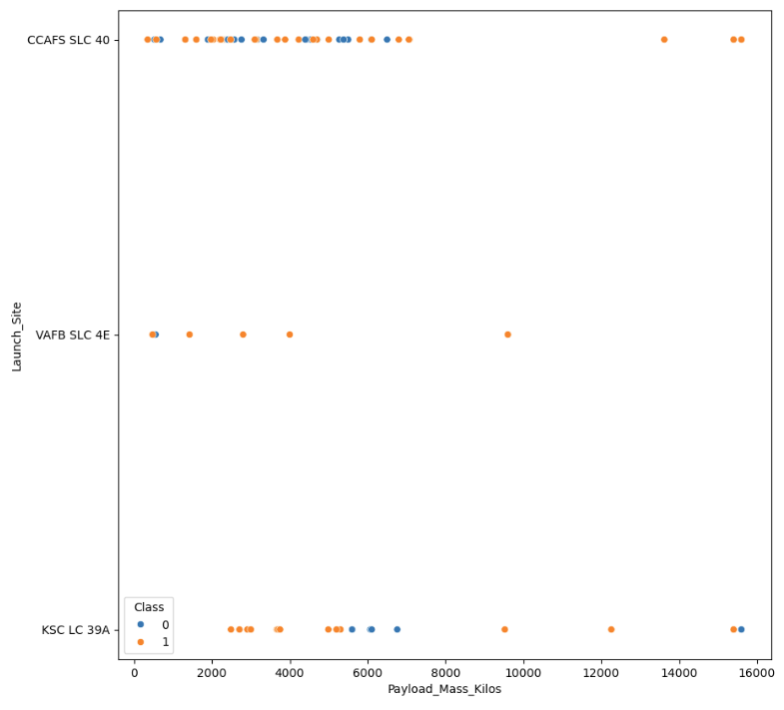
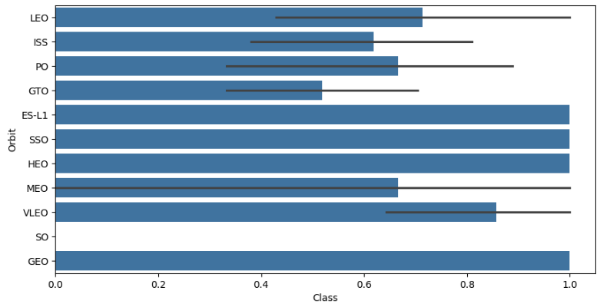
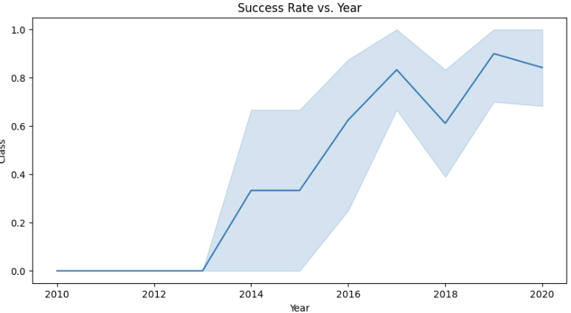
EDA with Data Visualization
Conducted EDA with Data Visualization for SpaceX dataset
Visualized the relationships between:
Flight number and payload to launch Site
success rate and flight number to each orbit type
Yearly launch success trend.
Feature engineering
Conversion to float64
GitHub URL - Link

Slide 12
EDA with SQL
Conducted EDA with SQL to SpaceX dataset which we injected into a PostgreSQL from Jupyter notebook.
Wrote multiple SQL queries
EDA analysis resulted in fetching –
names of launch site that are unique
payload mass by booster rockets
average payload mass vs F9
success vs failure counts, etc.
GitHub URL - Link
SELECT * FROM SPACEXTABLE WHERE Launch_Site LIKE 'CCA%' LIMIT 5;
SUCCESSFUL_LAUNCH_DATE
2015-12-22
SELECT Landing_Outcome, COUNT(*) as TOTAL_COUNT FROM SPACEXTABLE WHERE Date BETWEEN "2010-06-04" AND "2017-03-20" GROUP BY Landing_Outcome ORDER BY TOTAL_COUNT DESC;

Slide 13
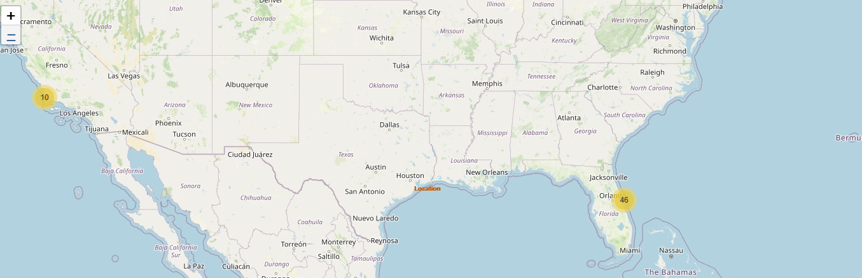
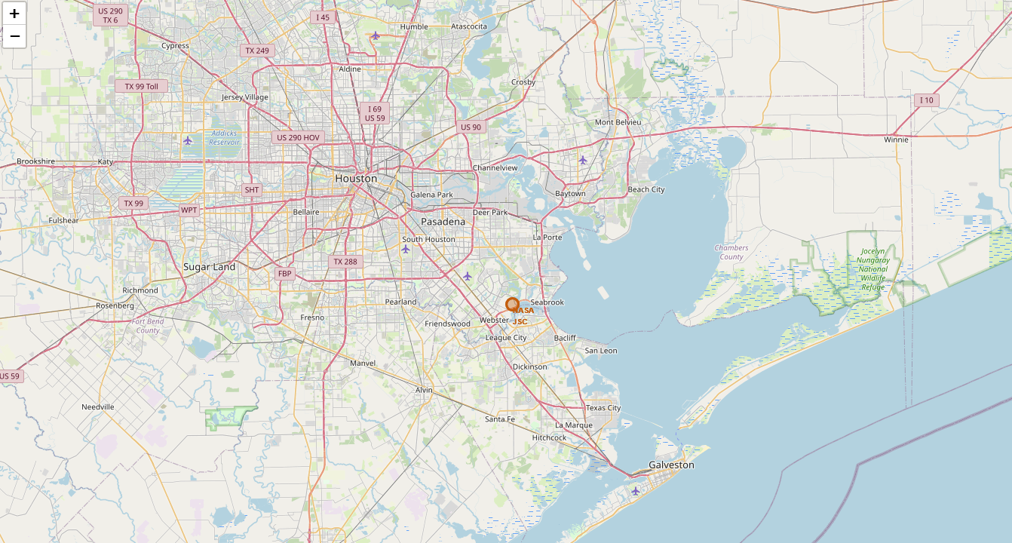
Build an Interactive Map with Folium
All launch sites were displayed on a Folium map using markers, circles, and indicators for launch success or failure.
Distances between each launch site and its surrounding proximities were computed.
GitHub URL - Link

Slide 14
Build a Dashboard with Plotly Dash
Designed an interactive dashboard with Plotly Dash.
Visualized total launches per site using pie charts.
Explored the relationship between launch outcome and payload mass (Kg) across booster versions with a scatter plot.
GitHub URL - Link

Slide 15
Predictive Analysis (Classification)
Preprocessed data with NumPy and Pandas and split into train/test sets.
Using GridSearchCV, built and tuned machine learning algorithms (Logistic Regression, SVC, Decision Tree Classifier, K Neighbors Classifier)
Improved performance with feature engineering and algorithm optimization.
Selected the best-performing classification model.
GitHub URL - Link
Load data
StandardizedScaler X
GridSearchCV
Convert Y

Slide 16
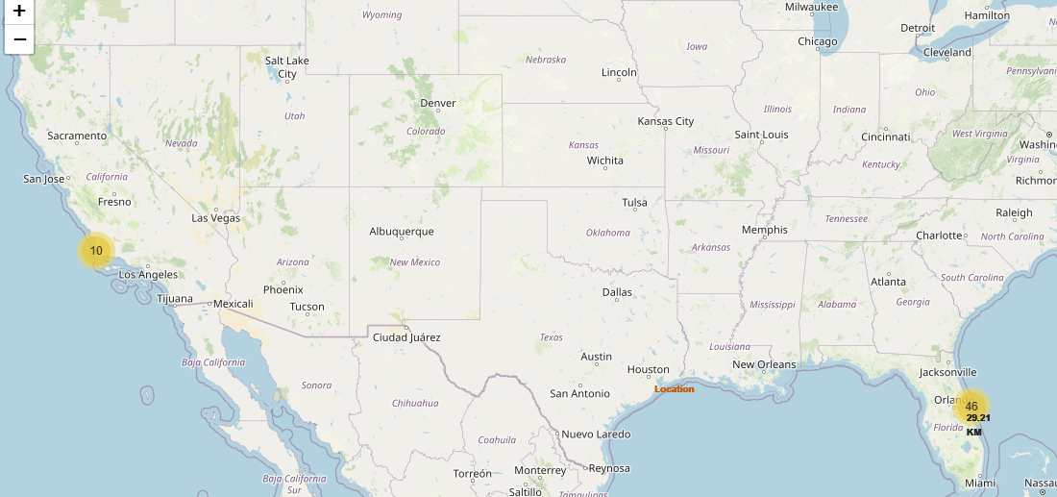
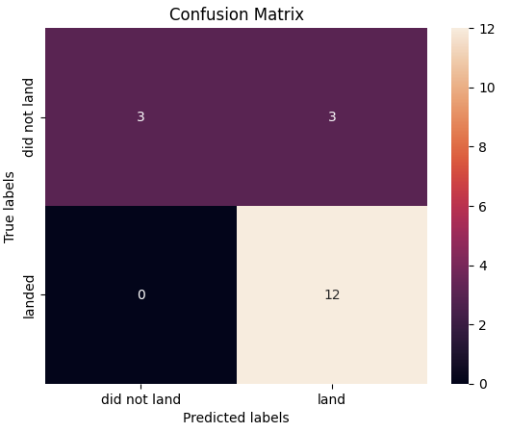
Results
Exploratory data analysis results
Orbits including ES-L1, Sun-Synchronous Orbit (SSO), Highly Elliptical Orbit (HEO), and Geostationary Orbit (GEO) often achieve impressive success levels.
Success rate increased steadily from 2013 to 2020.
Interactive analytics demo in screenshots
CCAFS SLC 40 has conducted the most launches, whereas VAFB SLC 4E demonstrates a greater rate of successful landings.
Launch sites are close to the coast and away from cities, highways and railways.
Predictive analysis results
Best Performing Algorithm is Decision Tree.

Slide 17

Section 2

Slide 18
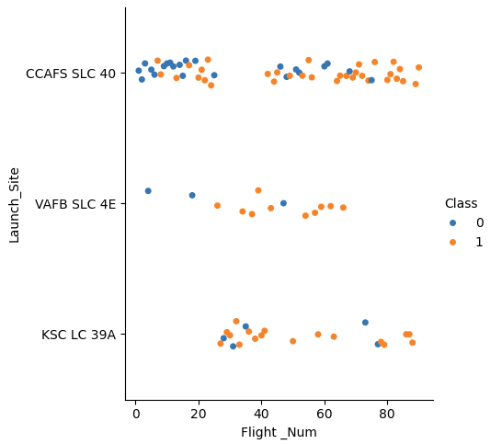
Flight Number vs. Launch Site
All launch sites experienced both successful and failed landings, with success rates increasing over time.
Early missions had higher failure rates, reflecting ongoing technological and process improvements.
CCAFS SLC 40 has the highest number of launches, while VAFB SLC 4E shows a higher proportion of successful landings.

Slide 19
Payload vs. Launch Site
All launch sites handle a broad range of payload masses, from lighter to heavier payloads.
Earlier missions generally carried lighter payloads and account for most landing failures.
This pattern suggests that technological or operational advancements improved success rates for heavier payloads.

Slide 20
Success Rate vs. Orbit Type
Orbits such as ES-L1, SSO, HEO, and GEO consistently demonstrate high success rates.
In contrast, GTO missions show more variable outcomes, indicating potential operational or technological challenges.
The SO orbit has insufficient data for reliable analysis due to having only one launch.

Slide 21
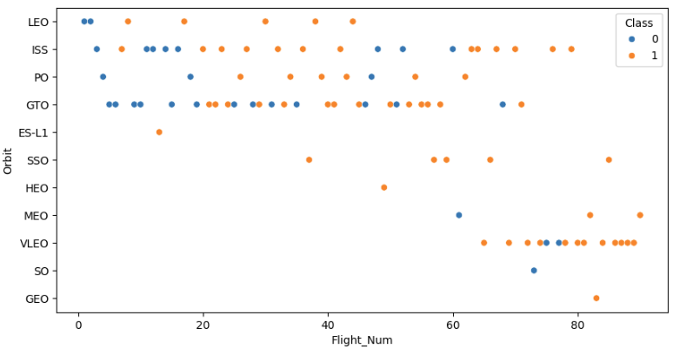
Flight Number vs. Orbit Type
Multiple orbit types appear across the range of flight numbers, while some are only attempted in later missions.
Landing success rates improve as flight numbers increase, reflecting accumulated experience and continuous advancements.

Slide 22
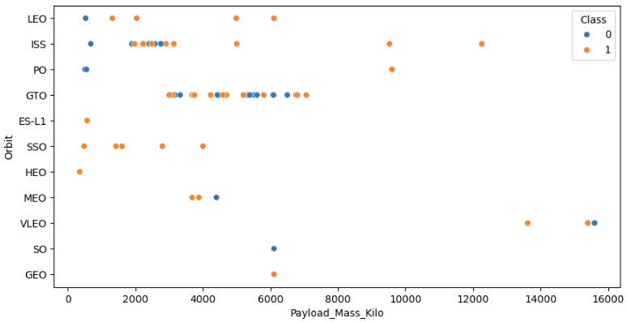
Payload vs. Orbit Type
Several orbit types span a wide range of payload masses, while SSO, MEO, HEO, and GEO are generally limited to lower payload ranges.
Orbits with more constrained payload ranges tend to exhibit higher landing success rates.
Although payload mass alone does not directly determine mission success, its interaction with orbit type shows a meaningful correlation.

Slide 23
Launch Success Yearly Trend
The yearly trend shows a steady transition from early difficulties to high reliability in first-stage landings.
Starting in 2016, SpaceX achieved consistent year-over-year improvements in success rates, with a minor decline in 2018.

Slide 24
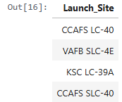
All Launch Site Names
There are four unique launch sites
SELECT DISTINCT Launch_Site from SPACEXTABLE;

Slide 25
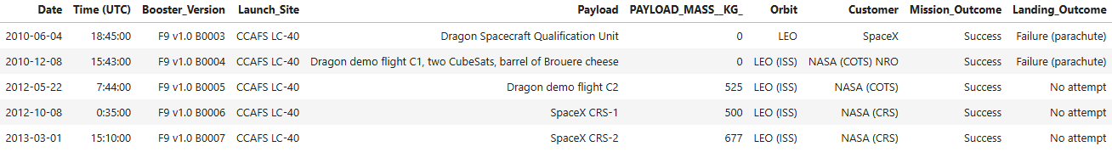
Launch Site Names Begin with 'CCA'
SELECT * FROM SPACEXTABLE WHERE Launch_Site LIKE 'CCA%' LIMIT 5;

Slide 26
Total Payload Mass
SELECT SUM(PAYLOAD_MASS__KG_) AS PAYLOAD_MASS_SUM FROM SPACEXTABLE WHERE Customer='NASA (CRS)';
PAYLOAD_MASS_SUM
45596

Slide 27
Average Payload Mass by F9 v1.1
SELECT AVG(PAYLOAD_MASS__KG_) AS PAYLOAD_MASS_AVERAGE FROM SPACEXTABLE WHERE Booster_Version LIKE 'F9 v1.1%';
PAYLOAD_MASS_AVERAGE
2534.6666666666665

Slide 28
First Successful Ground Landing Date
SELECT MIN(Date) as SUCCESSFUL_LAUNCH_DATE FROM SPACEXTABLE WHERE Landing_Outcome = 'Success (ground pad)';
SUCCESSFUL_LAUNCH_DATE
2015-12-22

Slide 29
Successful Drone Ship Landing with Payload between 4000 and 6000
SELECT Booster_Version, PAYLOAD_MASS__KG_ FROM SPACEXTABLE WHERE Landing_Outcome="Success (drone ship)" AND PAYLOAD_MASS__KG_ BETWEEN 4000 AND 6000;
Booster_Version | PAYLOAD_MASS__KG_
F9 FT B1022 | 4696
F9 FT B1026 | 4600
F9 FT B1021.2 | 5300
F9 FT B1031.2 | 5200

Slide 30
Total Number of Successful and Failure Mission Outcomes
SELECT CASE WHEN Mission_Outcome LIKE 'Success%' THEN 'Success' WHEN Mission_Outcome LIKE 'Failure%' THEN 'Failure' END as Mission_Result,COUNT(*) FROM SPACEXTABLE GROUP BY Mission_Result
Mission_Result | COUNT(*)
Failure | 1
Success | 100

Slide 31
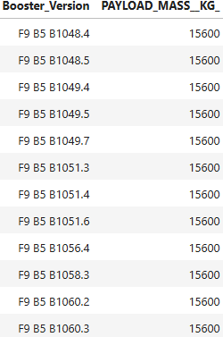
Boosters Carried Maximum Payload
SELECT DISTINCT Booster_Version, PAYLOAD_MASS__KG_ FROM SPACEXTABLE WHERE PAYLOAD_MASS__KG_=(SELECT MAX(PAYLOAD_MASS__KG_) FROM SPACEXTABLE) ORDER BY Booster_Version;

Slide 32
2015 Launch Records
SELECT CASE strftime("%m",Date) WHEN "01" THEN "January" WHEN "02" THEN "February" WHEN "03" THEN "March" WHEN "04" THEN "April" WHEN "05" THEN "May" WHEN "06" THEN "June" WHEN '07' THEN 'July' WHEN '08' THEN 'August' WHEN '09' THEN 'September' WHEN '10' THEN 'October' WHEN '11' THEN 'November' WHEN '12' THEN 'December'
END as MONTH_NAME, Landing_Outcome, Booster_Version, Launch_Site, Date FROM SPACEXTABLE WHERE strftime("%Y",Date)="2015" AND Landing_Outcome="Failure (drone ship)";
MONTH_NAME | Landing_Outcome | Booster_Version | Launch_Site | Date
January | Failure (drone ship) | F9 v1.1 B1012 | CCAFS LC-40 | 2015-01-10
April | Failure (drone ship) | F9 v1.1 B1015 | CCAFS LC-40 | 2015-04-14

Slide 33
Rank Landing Outcomes Between 2010-06-04 and 2017-03-20
SELECT Landing_Outcome, COUNT(*) as TOTAL_COUNT FROM SPACEXTABLE WHERE Date BETWEEN "2010-06-04" AND "2017-03-20" GROUP BY Landing_Outcome ORDER BY TOTAL_COUNT DESC;
Landing_Outcome | TOTAL_COUNT
No attempt | 10
Success (drone ship) | 5
Failure (drone ship) | 5
Success (ground pad) | 3
Controlled (ocean) | 3
Uncontrolled (ocean) | 2
Failure (parachute) | 2
Precluded (drone ship) | 1

Slide 34

Section 3

Slide 35
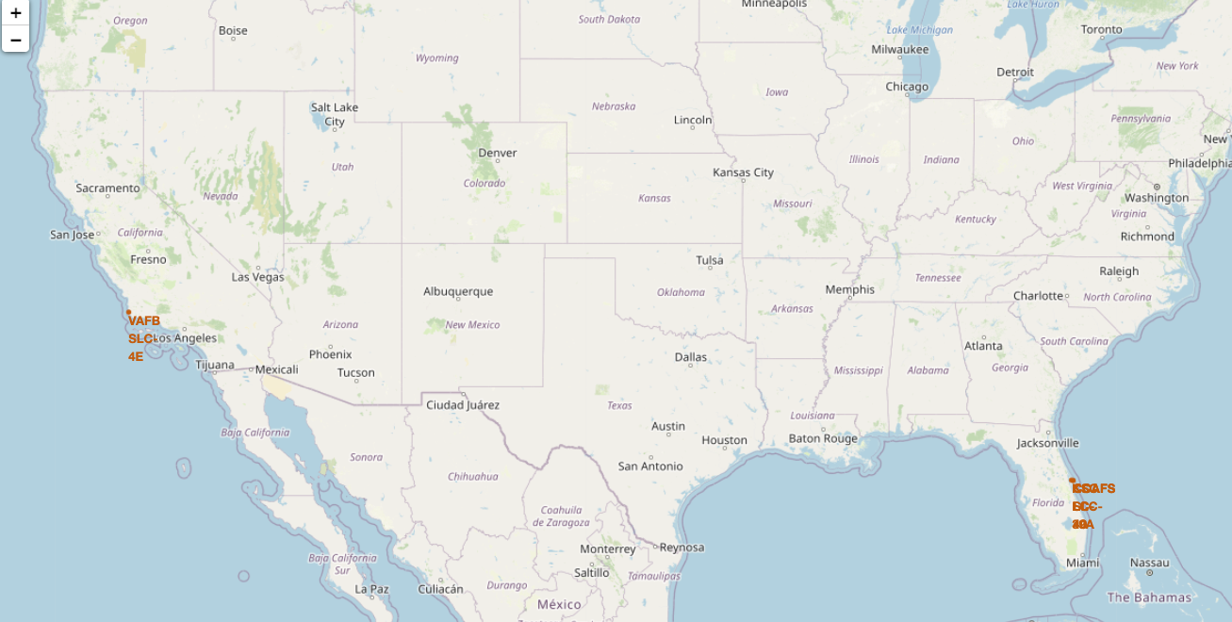
Launch Site Locations
Launch sites are located near coastal areas in general.
This is possibly due to p public safety reasons.

Slide 36
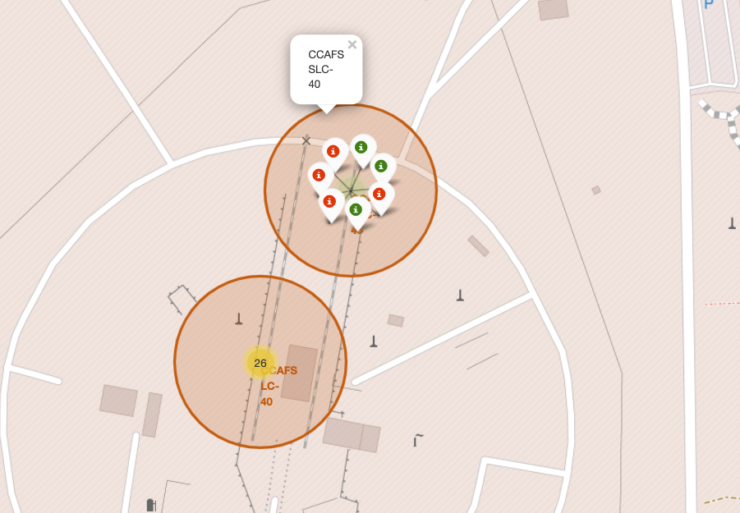
Launch Outcomes
It is observed that Florida launches were split unevenly between successful (green) while other were not (red).

Slide 37
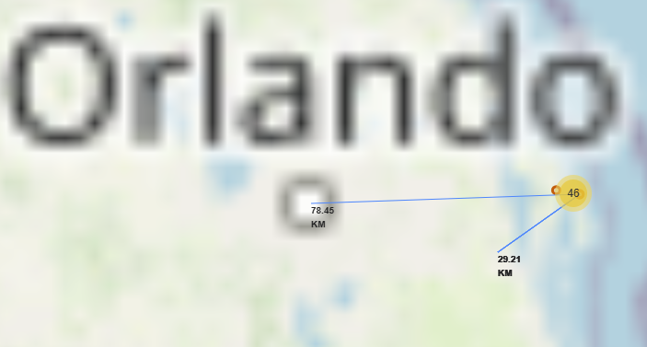
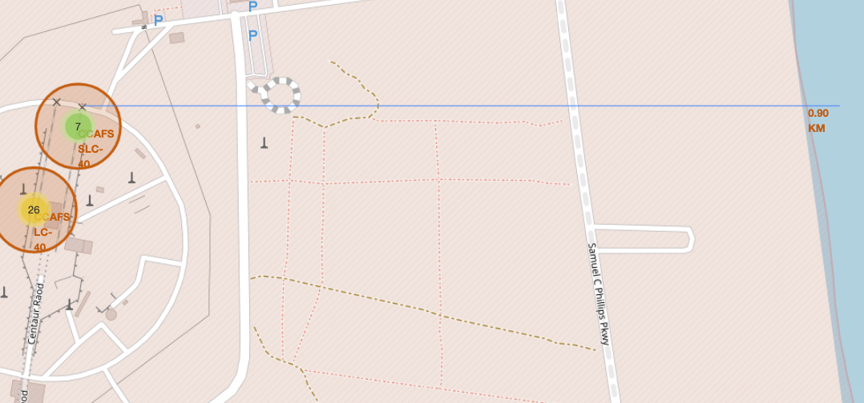
Launch Location Proximities
Launch sites are close to the coast
Launch sites are away from cities, highways and railways.

Slide 38

Section 4

Slide 39
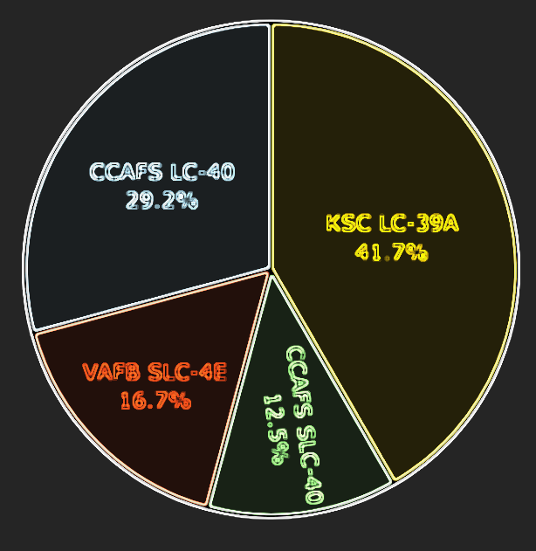
Success Rate by Launch Site
Most successful launches in order:
KSC LC-39A
CCAFS LC-40
VAFB SLC-4E
CCAFS SLC-40

Slide 40
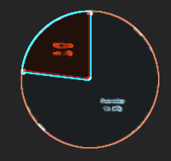
Top Launch Site Success to Failure Rate
KSC LC-39A launch site stats:
Success – 76.9%
Failure – 23.1%

Slide 41
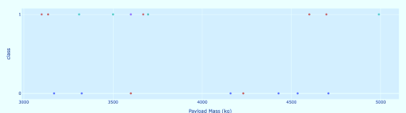
Payload Size to Lauch Success Rate
The success rate increases for lower weight payloads.
For higher weight payloads, the success rate decreases.

Slide 42

Section 5

Slide 43
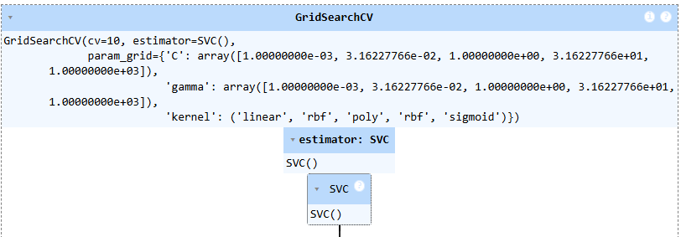
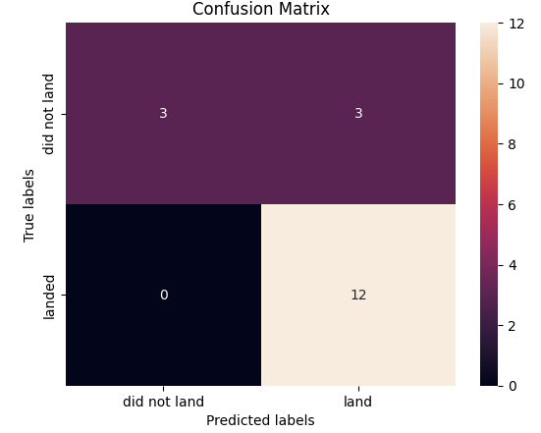
Classification Accuracy
DecisionTree classifier had the higher accuracy of all the different models tested.

Slide 44
Confusion Matrix
12 successful landings were predicted
3 unsuccessful landings were predicted
3 unsuccessful landings were predicted
0 unsuccessful landings were predicted

Slide 45
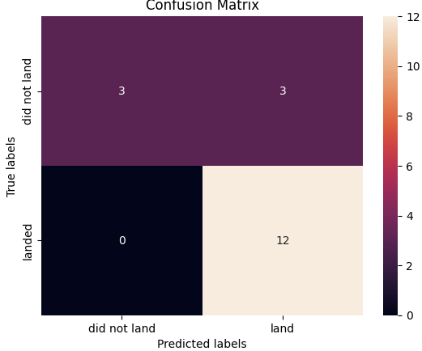
Conclusions
Orbits including ES-L1, Sun-Synchronous Orbit (SSO), Highly Elliptical Orbit (HEO), and Geostationary Orbit (GEO) often achieve impressive success levels.
Success rate increased steadily from 2013 to 2020.
CCAFS SLC 40 has conducted the most launches, whereas VAFB SLC 4E demonstrates a greater rate of successful landings.
Launch sites are close to the coast and away from cities, highways and railways.
Best Performing Algorithm is Tree.

Slide 46
Appendix
SpaceX API
List of Falcon 9 and Falcon Heavy launches (Wikipedia)
Dataset_part_1.csv
Dataset_part_2.csv
Spacex_launch_geo.csv
Spacex_launch_dash.csv

Slide 47


